Slide 1




CREDIT DECODED
A HOLISTIC APPROACH TO FINANICAL HEALTH AND CONFIDENCE
Jacalyn Forleo
Zenith Home Loans
JACALYN FORLEO ZENITH HOME LOANS NMLS 1016776

Slide 2

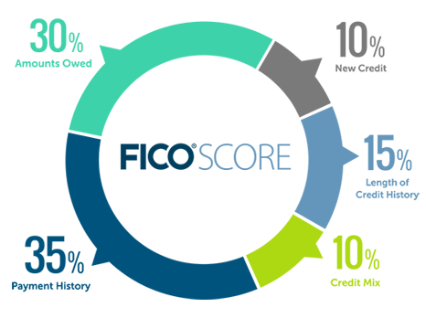

WHAT IS CREDIT?
A credit score shows lenders how likely you are to repay your debts. The higher your score, the better.
A credit score is made up of Payment History (35%), Credit Utilization (30%), Credit History Length (15%), New Credit (10%), and Credit Mix (10%)
Scores range from 300-850
JACALYN FORLEO ZENITH HOME LOANS NMLS 1016776
Notes:
Payment History (35%): This is the most crucial piece of your credit profile, accounting for roughly 35% of your score. It makes sense too. If you've been diligent in the past, chances are you'll be trustworthy in the future. So, it's wise to avoid late payments like the plague.
Credit Utilization (30%): The amounts you owe, or your credit utilization, is the second most critical factor, making up about 30% of your score. Interestingly, having a good credit score doesn't imply that you don't borrow. In fact, not using your credit is often worse than using lots of it. Strive to show that you can manage a reasonable amount of debt responsibly.
Length of Credit History (15%): This factor accounts for 15% of your score. It's a bit like those old movies where a shop owner lets regular customers run a tab because they trust they'll settle it. The same principle applies to credit. The longer you've been borrowing, the more creditworthy you appear.
Types of Credit (10%): This reviews how many sources of borrowing you use, such as car loans, mortgages, or credit cards. Here, diversity is key. The more varied your sources, the better for your score.
New Credit (10%): This takes into account how often you apply for new credit, like requesting a credit card from all your favorite new stores. It's best not to take on credit you don't need, as it can negatively affect your score.

Slide 3
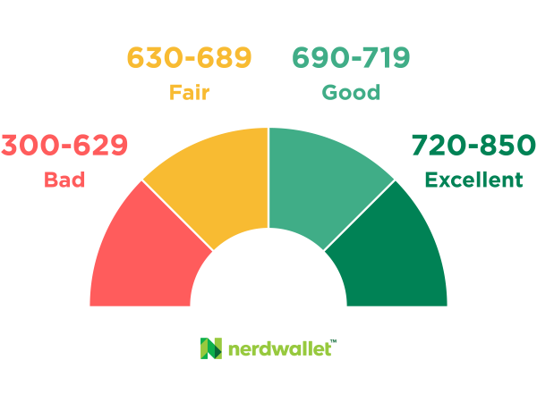
UNDERSTANDING FICO
The most common credit scoring model is called the FICO. There are three FICO scores, one from each of the major credit bureaus: Experian, TransUnion, and Equifax. Each score will be slightly different based on the information that credit bureau has on file about you.
Your credit score will range from 300 to 850, and there's a lot you can do to ensure you're on the right path to a stellar credit score.
JACALYN FORLEO ZENITH HOME LOANS NMLS 1016776
Notes:
Fico = Fair Isaac Corporation - scoring model

Slide 4




ESTABLISHING POSITIVE CREDIT
  APPLY FOR A CREDIT CARD
  USE YOUR CREDIT RESPONDSIBLY
  MAKE PAYEMENTS ON TIME
  KEEP YOUR ACCOUNTS OPEN
  CONSIDER DIFFERENT TYPES OF CREDIT
  MONITOR YOUR CREDIT
JACALYN FORLEO ZENITH HOME LOANS NMLS 1016776

Slide 5

CREDIT CARD RULES TO FOLLOW
  Don’t Max out your credit card
  Always pay more than the minimum payment
  Review your monthly statements for accuracy
  Avoid Cash Advances
  Monitor your spending
  Understand your Rate and Terms
JACALYN FORLEO ZENITH HOME LOANS NMLS 1016776

Slide 6


HOW TO FIX
‘BAD’ CREDIT
  No late payments
  Settle any collections
  Keep balances 30% or less when possible
  Set up Auto-pay
  Snowball effect to debt pay off
JACALYN FORLEO ZENITH HOME LOANS NMLS 1016776

Slide 7

PAYOFF AND DEBT CONSOLIDATION
  SAVE 10% OF YOUR EARNINGS
  LIVE WITHIN YOUR MEANS/CREATE A BUDGET
  INVEST!
  PROTECT YOUR WEALTH
  BUY A HOME
  CREATE PASSIVE INCOME
  INVEST IN YOURSELF
JACALYN FORLEO ZENITH HOME LOANS NMLS 1016776
Notes:
Lesson #1: Start thy purse to fattening
“Start thy purse to fattening” (aka pay yourself first) means saving at least 10% of your income every month, no matter how small it may be.
By doing so, you’ll have a cushion to fall back on in case of emergencies, and you can use the savings to invest in your future.
Lesson #2: Control thy expenditure
A famous rule in the world of personal finance is to live below your means and avoid frivolous spending. Keep track of your expenses, and make sure you’re spending your money wisely.
Lesson #3: Make thy gold multiply
Saving money every month and controlling your spending will get you halfway there. But let’s not forget something here – inflation. You don’t want to be putting all your efforts into saving your hard-earned money, only to have it lose value over time. The way to grow your money is to make it work for you (aka investing)
Lesson #4: Guard thy treasure against loss
The principle suggests that one should protect their wealth and ensure it is invested in the right option to avoid losing it. This means being mindful of where and how one invests money. How? Be smart by doing your research and understanding the ins and out of your investment choice.
"Diversify"
“Don’t put all your eggs in one basket,” the old saying states. Another strategy to protect your money is by investing in different investment options and spreading the risk across different assets.
Lesson #5: Make of thy dwelling a profitable investment
buying your own home to
free yourself of paying rent every month. In turn, you will be more in control of your own life and not drown in expenses.
Lesson #6: Ensure a future income
The day will come when you’ll retire, so plan ahead. Look for ways to create passive income streams that will provide a consistent income without requiring constant effort. This can be in the form of rental properties, stocks, or other investments.
Lesson #7: Increase thy ability to earn
Invest in yourself and your education. Continuously seek ways to improve your skills and knowledge, so you can earn more and command a higher salary.

Slide 8

STUDENT LOANS
  Are any of your loans in Default?
  Get on a Repayment Plan (IDR)
  Enroll in Auto Pay - you’ll save .25% in interest on federal loans
  Do you qualify for Loan forgiveness?
JACALYN FORLEO ZENITH HOME LOANS NMLS 1016776
Notes:
https://studentaid.gov/manage-loans/repayment/prepare-payments-restart#to-do

Slide 9

CREDIT AND HOUSING
  Minimum Credit score for a home : 580 (620 for Down Payment Assistance)
  Debt to income (DTI) Compares your monthly debt to your monthly income
  Max DTI is 55% (IE Total monthly debts + housing/income)
JACALYN FORLEO ZENITH HOME LOANS NMLS 1016776

Slide 10

  Mortgage loan approval requires a ‘hard’ credit pull/inquiry. You can do a ‘soft’ pull/inquiry at anytime to check your scores with no impact to your credit.
  Multiple Inquires can impact your scores (6+)
JACALYN FORLEO ZENITH HOME LOANS NMLS 1016776
Notes:
People with multiple credit inquires are 8x more likely to file for BK than those with none.
You can have your credit pulled by multiple mortgage lenders in a 15-45 day period with only 1 inquiry impacting your score

Slide 11
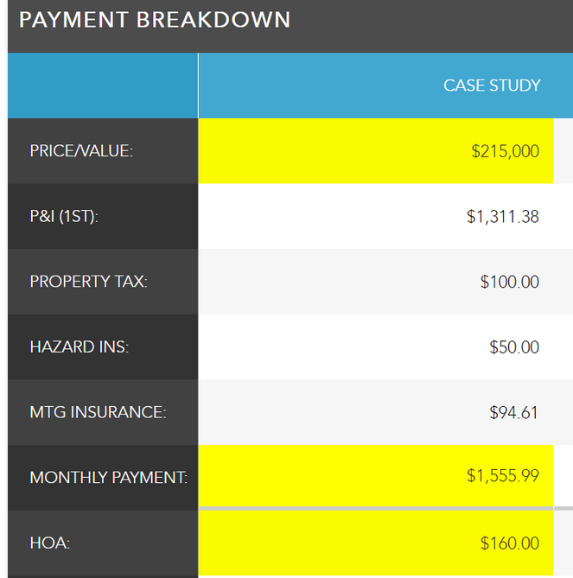
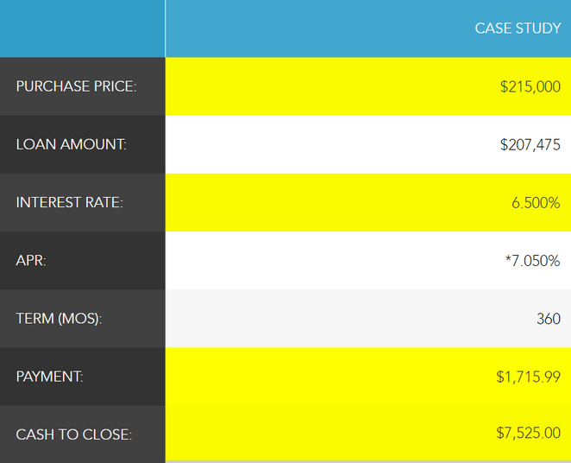
HOW DEBT INPACTS YOUR ABILITY TO BUY A HOME
CASE STUDY :
INCOME : $50,000 OR $4166.67/MONTH
CAR PAYMENT : $350
STUDENT LOAN : $150
CREDIT CARD : $75
MAX FHA DTI : 55% OR $2,291
MONTHLY HOUSE PAYMENT MAX = $1,716
JACALYN FORLEO ZENITH HOME LOANS NMLS 1016776

Slide 12




THANK YOU FOR LISTENING
Jacalyn Forleo
Mortgage Loan Originator NMLS 1016776
Zenith Home Loans
7400 E Crestline Circle #200 Greenwood Village CO 80111
Jacalyn@loansbyjacalyn.com 720.512.5494
DISCLAIMER:
Zenith Home Loans does Business in Accordance with Federal Fair Lending Laws. NMLS ID 1818094. CO: Mortgage Company Registration 1818094. Regulated by the CO Division of Real Estate. Zenith is not acting on behalf of or at the direction of the FHA/HUD or the Federal Government. This product or service has not been approved or endorsed by any governmental agency, and this offer is not being made by any agency of the government. Information, rates, and programs are subject to change without notice. All products are subject to credit and property approval. Not all products are available in all states or for all loan amounts. Other restrictions may apply. This is not an offer to enter into an agreement. Not all customers will qualify.

